Slide 1
PORTFOLIO DIVERSIFICATION
BY: TIRTH PATEL
KHOOSHI AJMERA
ABHIMANYU SHETH
ADVISOR: CRISTIAN HOMESCU
12/15/2023

Slide 2
What is our Project about?
Correlation between stocks from different sectors in the portfolio across different timelines
Market regimes
Portfolio Optimization

Slide 3
Methodology
Data Source - Bloomberg
Network Analysis and Correlation matrices for Correlation
Clustering for Asset Grouping
GMV and MVO methods for computing weights
Comparing the optimized portfolio with the benchmark

Slide 4
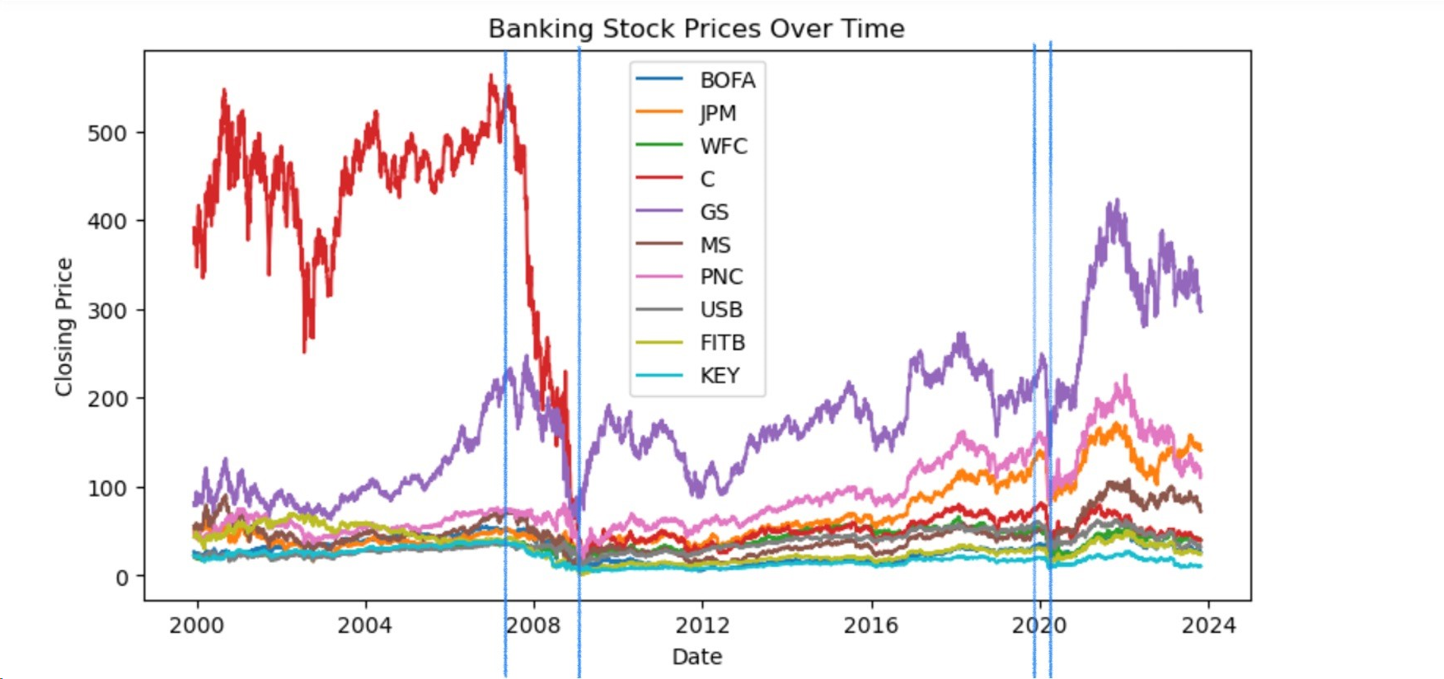
EDA FOR BANKING SECTOR

Slide 5
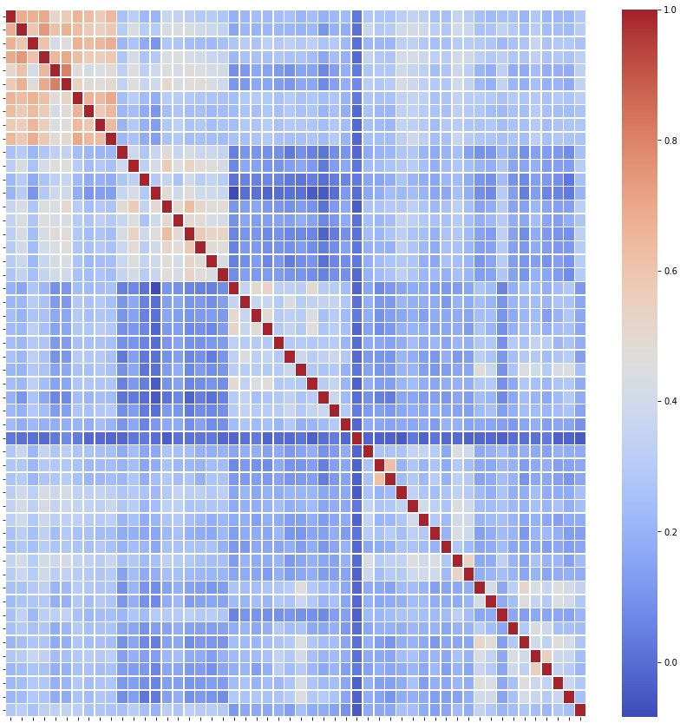
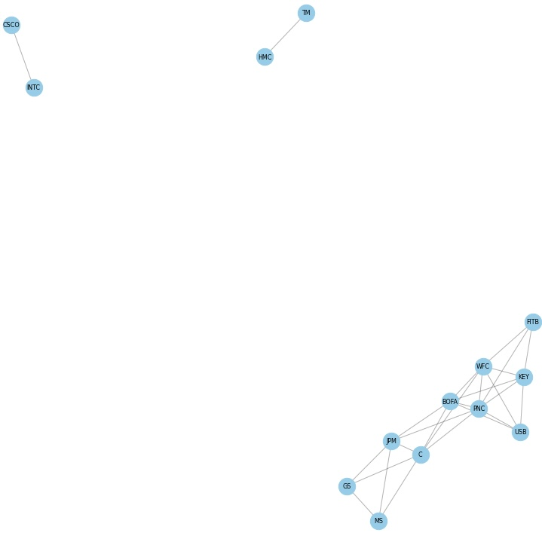
CORRELATION HEATMAP AND NETWORK GRAPH
(2000-01-01 to 2007-11-30)
BANKING
TECH
FMCG
AUTO
PHARMA
BANKING TECH FMCG AUTO PHARMA

Slide 6
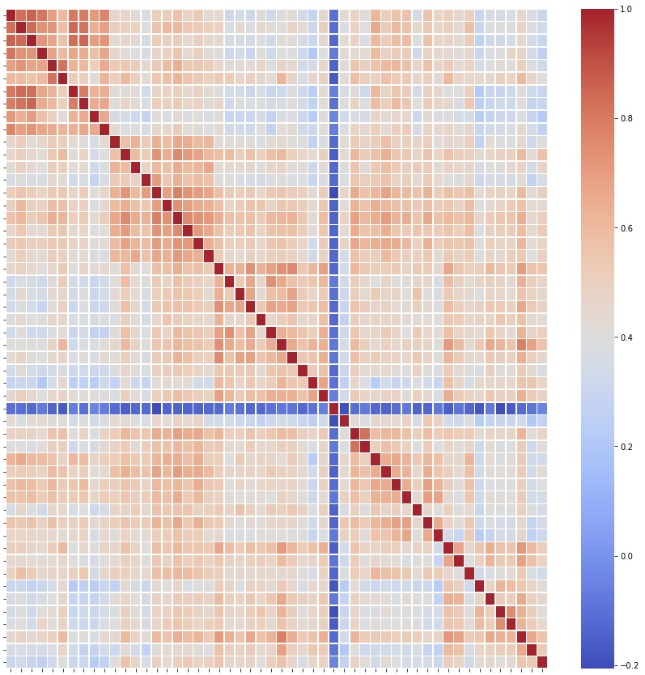
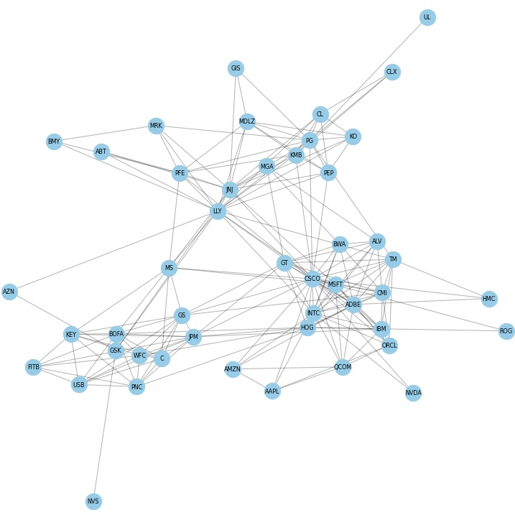
CORRELATION HEATMAP AND NETWORK GRAPH
(2007-12-01 to 2009-06-30)
BANKING
TECH
FMCG
AUTO
PHARMA
BANKING TECH FMCG AUTO PHARMA

Slide 7
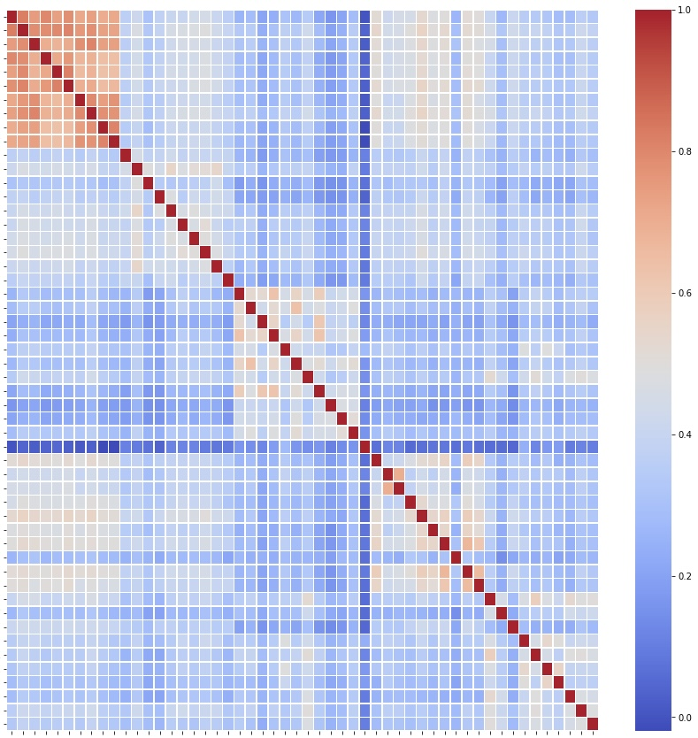
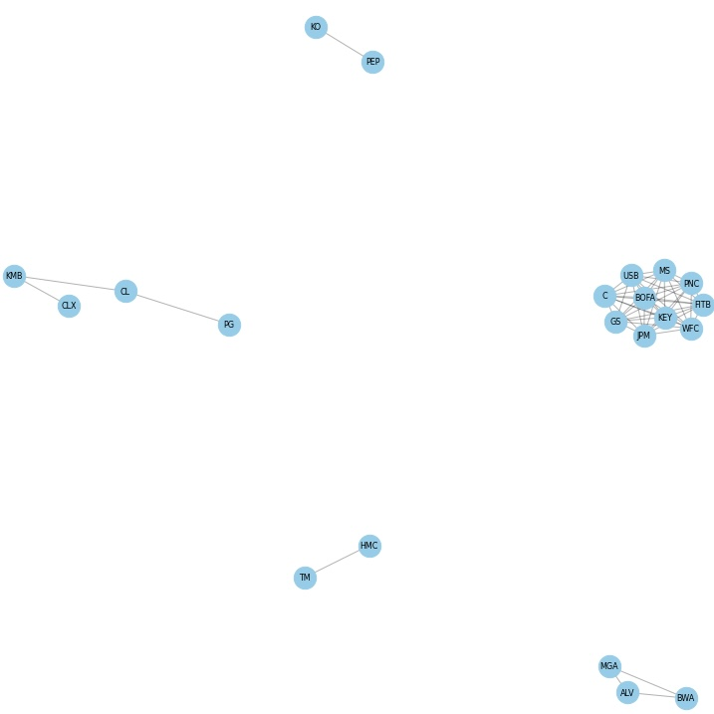
CORRELATION HEATMAP AND NETWORK GRAPH
(2009-07-01 to 2020-02-19)
BANKING
TECH
FMCG
AUTO
PHARMA
BANKING TECH FMCG AUTO PHARMA

Slide 8
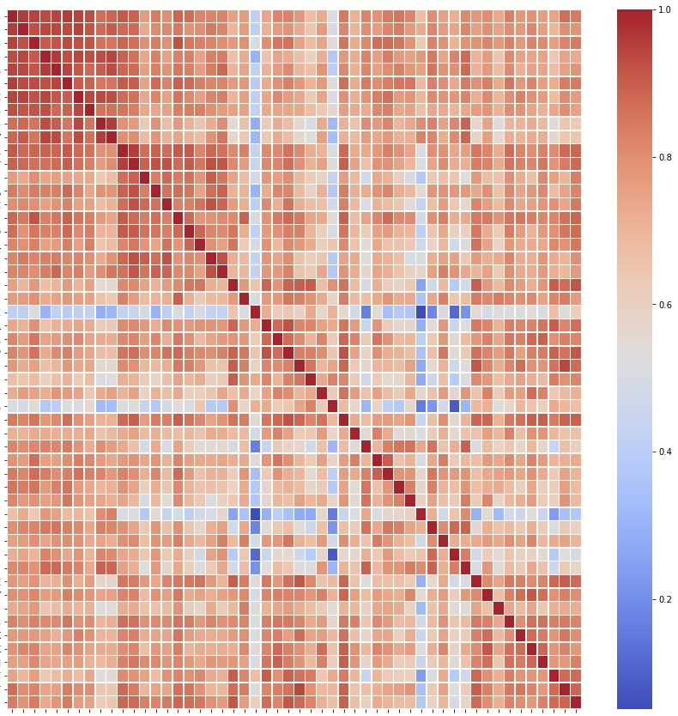
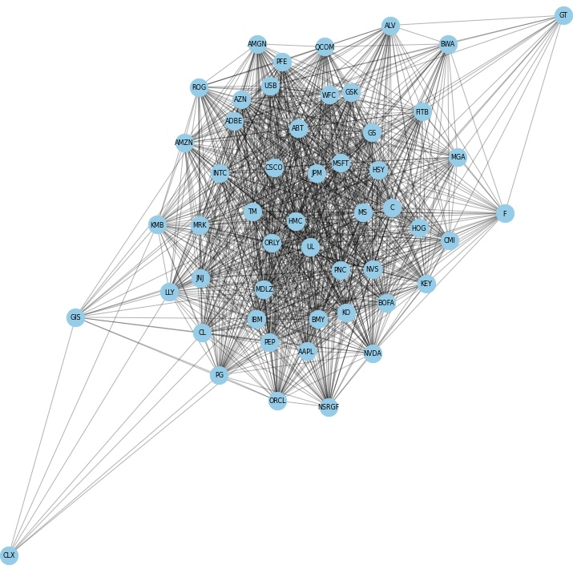
CORRELATION HEATMAP AND NETWORK GRAPH
(2020-02-20 to 2020-04-10)
BANKING
TECH
FMCG
AUTO
PHARMA
BANKING TECH FMCG AUTO PHARMA

Slide 9
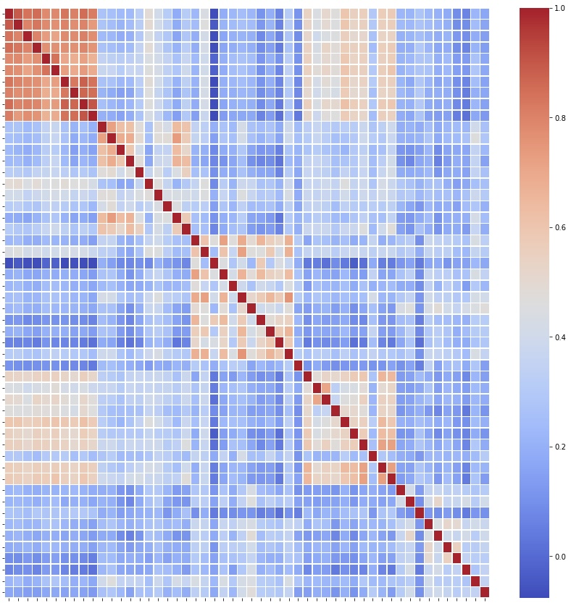
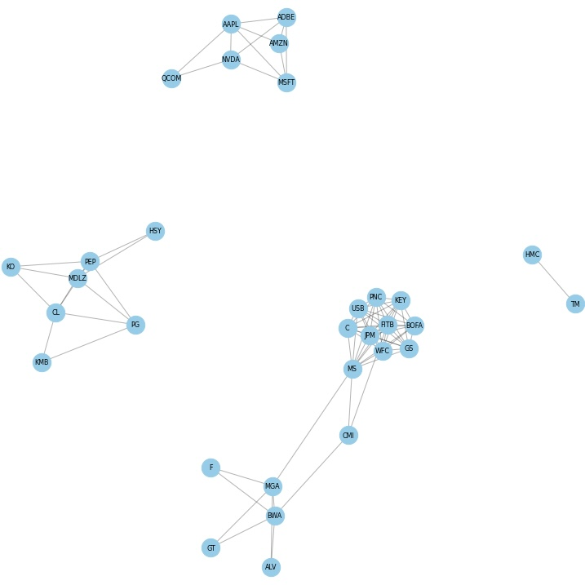
CORRELATION HEATMAP AND NETWORK GRAPH
(2020-04-13 to 2023-10-26)
BANKING
TECH
FMCG
AUTO
PHARMA
BANKING TECH FMCG AUTO PHARMA

Slide 10
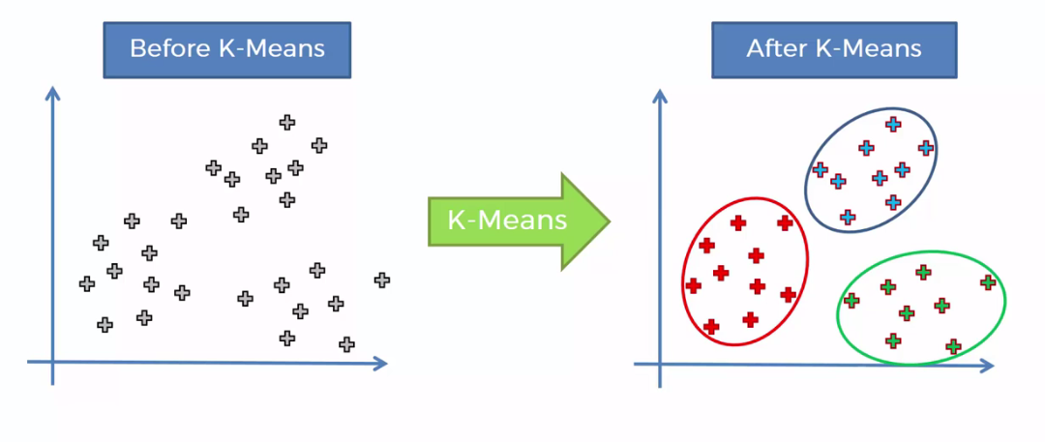
K-MEANS CLUSTERING

Slide 11
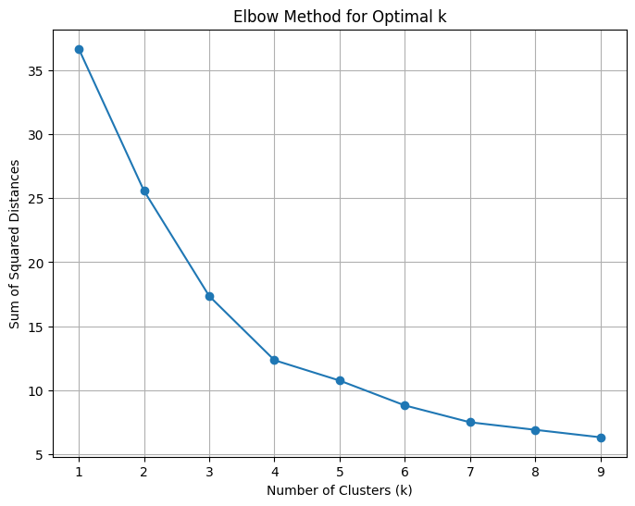
ELBOW METHOD FOR THE ENTIRE PERIOD

Slide 12
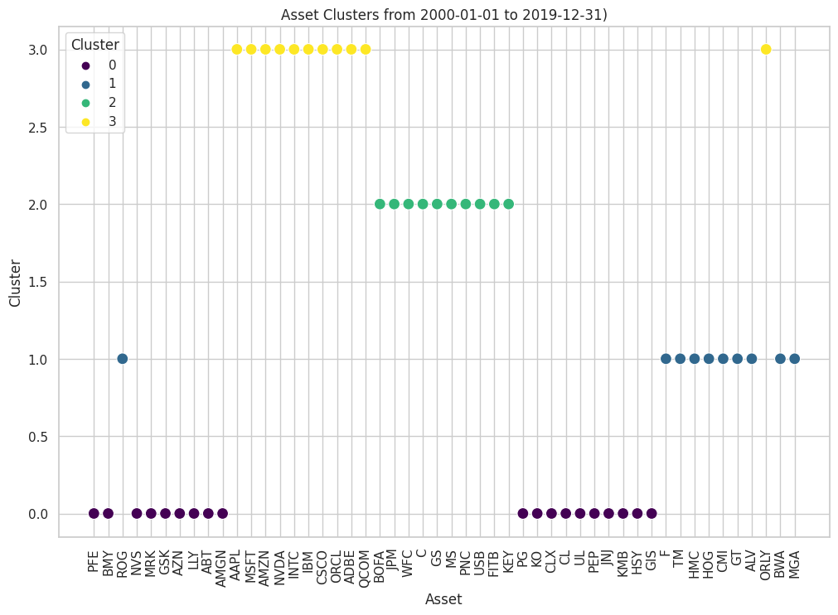
K-MEANS CLUSTERING FROM 2000-01-01 TO 2019-12-31

Slide 13
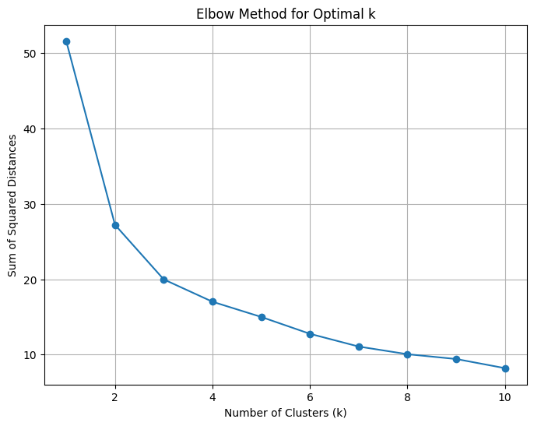
ELBOW METHOD DURING FINANCIAL CRISIS

Slide 14
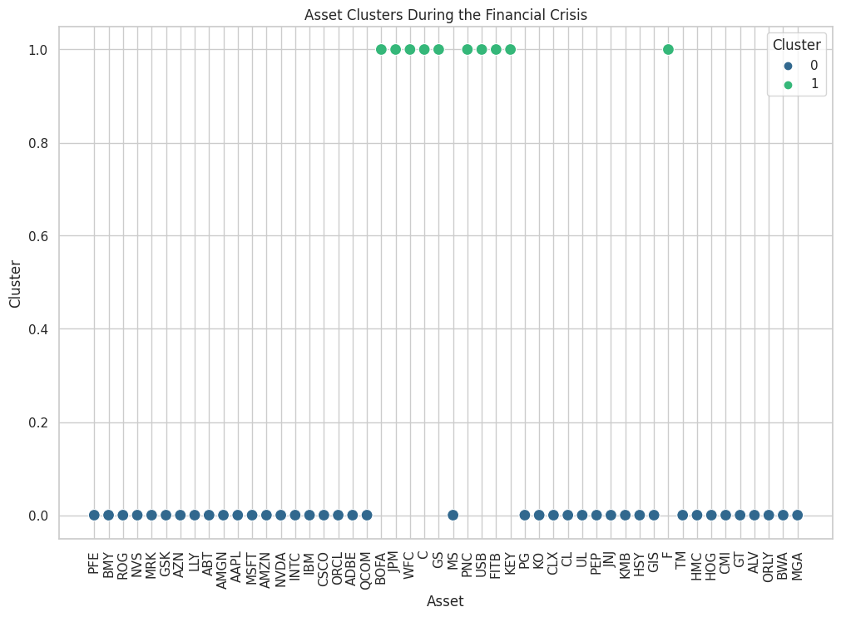
K-MEANS CLUSTERING FROM 2007-12-01 TO 2009-06-30

Slide 15
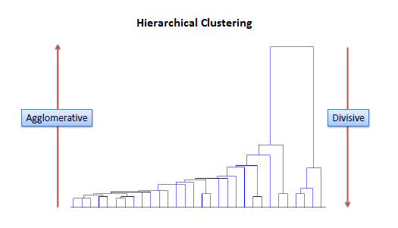
HIERARCHICAL CLUSTERING

Slide 16
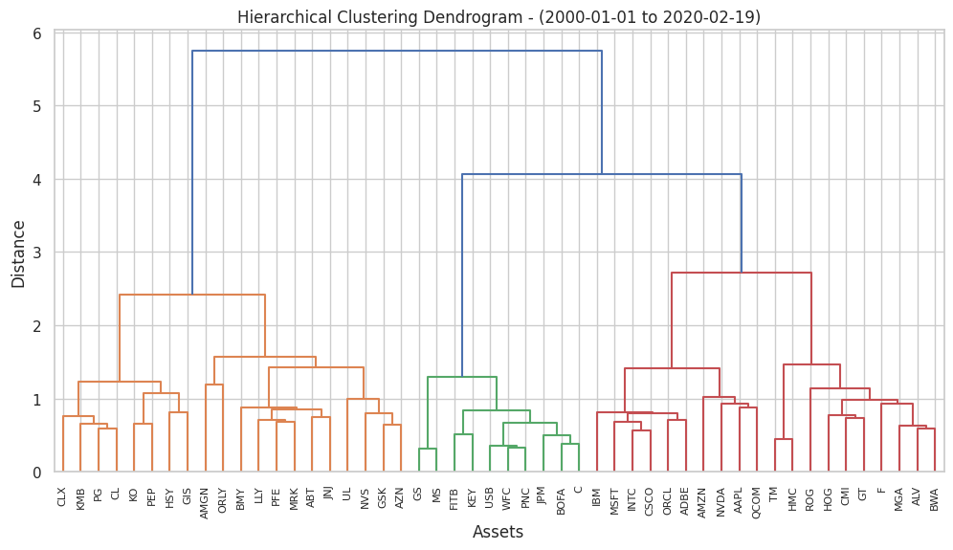
HIERARCHICAL CLUSTERING FROM 2000-01-01 TO 2019-12-31

Slide 17
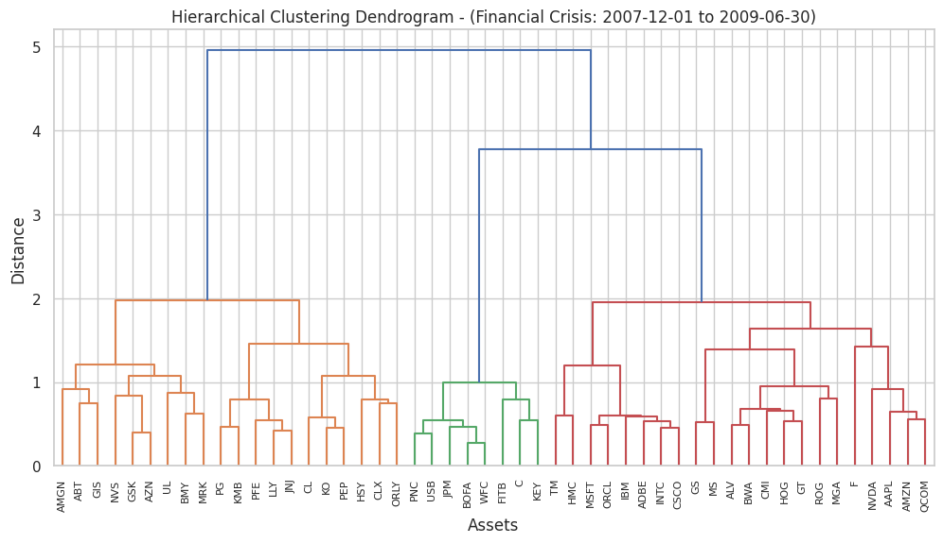
HIERARCHICAL CLUSTERING FROM 2007-12-01 TO 2009-06-30

Slide 18
COMPARISON AMONG CLUSTERING METHODS
FOR THE ENTIRE PERIOD
K-Means B) Hierarchical Clustering
FOR THE BANKING CRISIS PERIOD
A) K-Means B) Hierarchical Clustering
Silhouette Score : 0.35
Calinski Harabasz Score: 34.63
Davies Bouldin Score: 1.05
Silhouette Score : 0.28
Calinski Harabasz Score: 20.21
Davies Bouldin Score: 1.39
Silhouette Score : 0.34
Calinski Harabasz Score: 34.36
Davies Bouldin Score: 1.01
Silhouette Score : 0.33
Calinski Harabasz Score: 32.71
Davies Bouldin Score: 1.16

Slide 19

Market regimes
Financial Crisis 2008
Covid – 19
Government Bond Hike Rates

Slide 20
PORTFOLIOS CONSTRUCTED
Portfolio 1
Portfolio 3
'CLX', 'AMZN', 'GIS', 'HSY', 'NVDA
'CLX', 'AMZN', 'GIS', 'HSY', 'NVDA', 'ORLY', 'AZN', 'BMY', 'AAPL', 'AMGN
Portfolio 2
Portfolio 4
'CLX', 'AMZN', 'GIS', 'HSY', 'NVDA', 'ORLY', 'AZN'
'CLX', 'AMZN', 'GIS', 'HSY', 'NVDA', 'ORLY', 'AZN', 'BMY', 'AAPL', 'AMGN’, ‘PG', 'KMB', 'LLY'

Slide 21
Optimal Weights Calculation Method :
GMV
Mean Variance Optimization

Slide 22
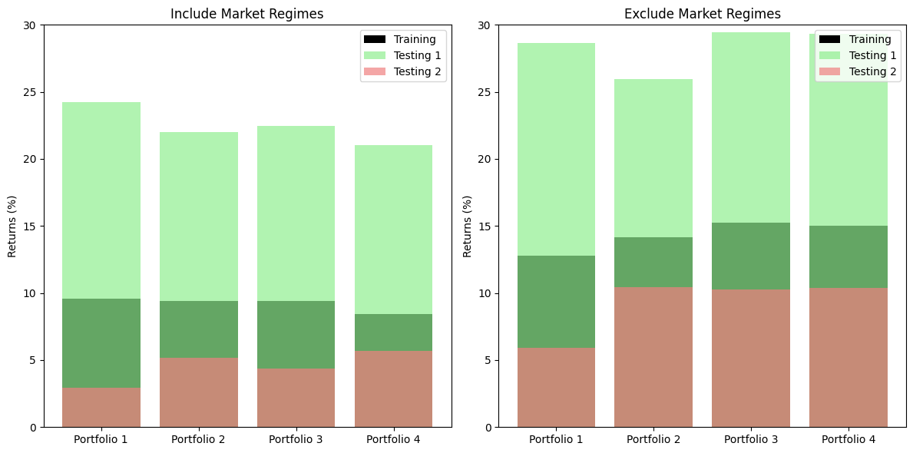
GMV Based Portfolio Returns

Slide 23
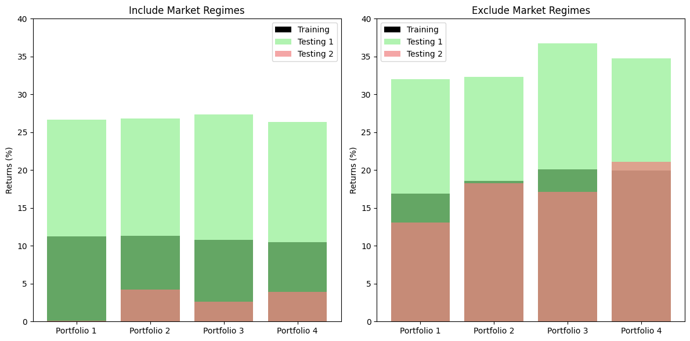
MVO Based Portfolio Returns

Slide 24
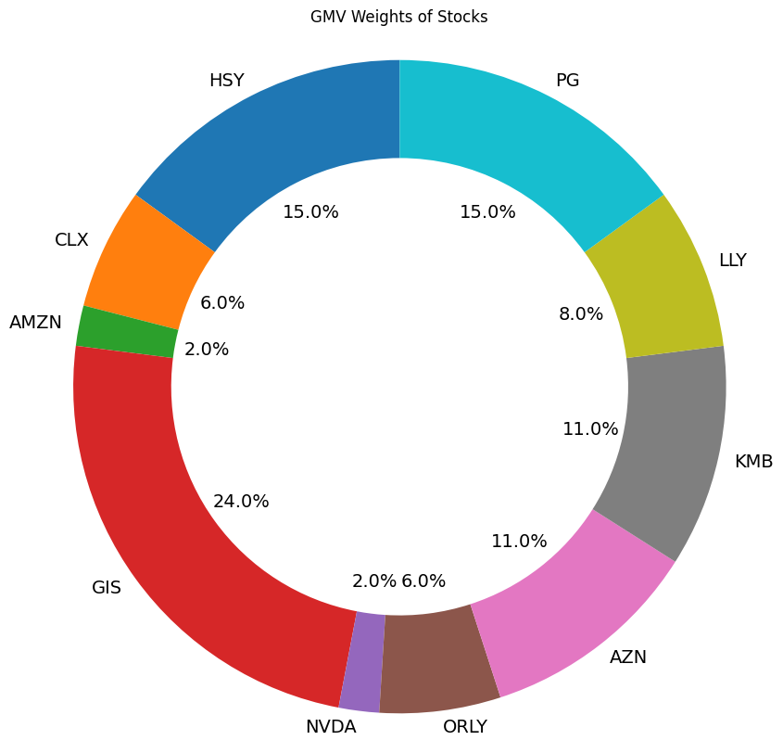
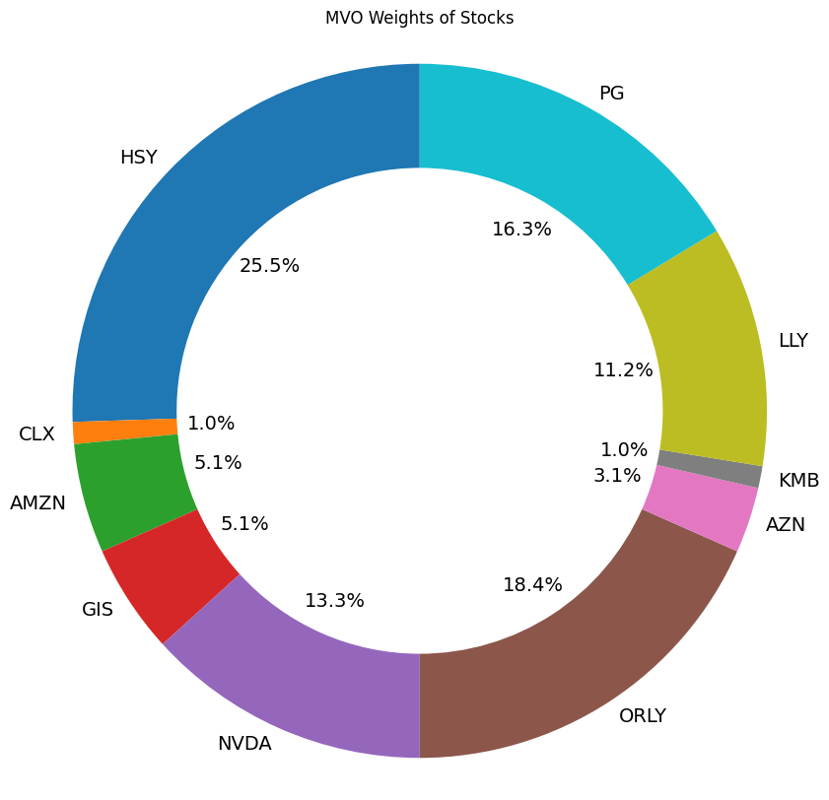
Comparison between GMV & MVO

Slide 25
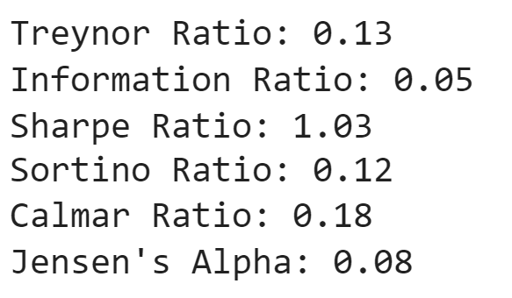
Performance Statistics

Slide 26
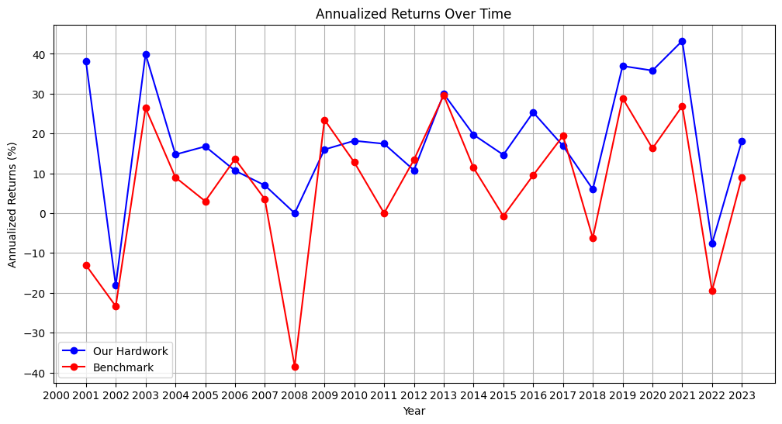
Comparison with S&P 500

Slide 27
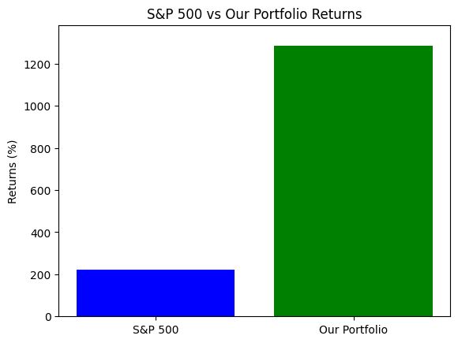
ABSOLUTE RETURNS OVER THE ENTIRE PERIOD

Slide 28
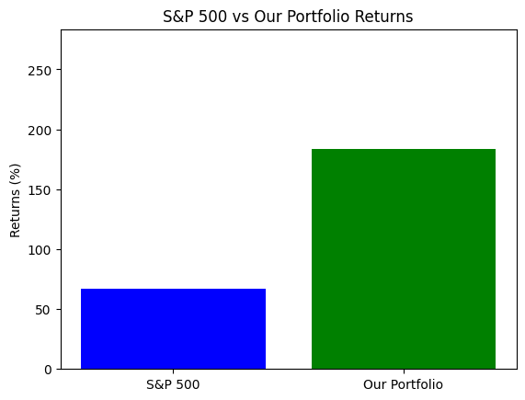
ABSOLUTE RETURNS OVER THE TESTING PERIOD

